Slide 1
Linear Multi-class Classifier

Slide 2
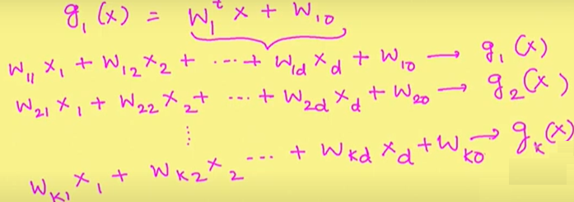
Multiclass problem- Linear machine
}
Score function
For the given instance score function gives what is the score value for different class

Slide 3
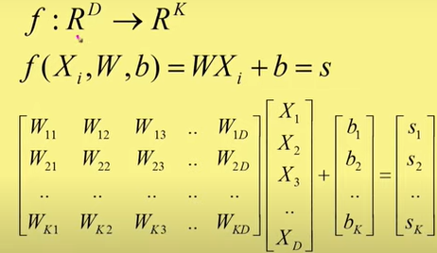

Slide 4
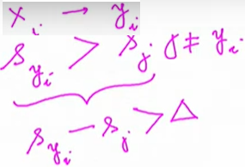
For any x_{i}εω_{i}, we want s_{yi} to be maximum. If it is not we will need to update parameters.
To have more confidence in our classification we want not only s_{yi} to be maximum but also (SVM)

Slide 5
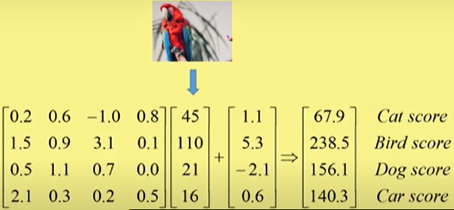
Example

Slide 6
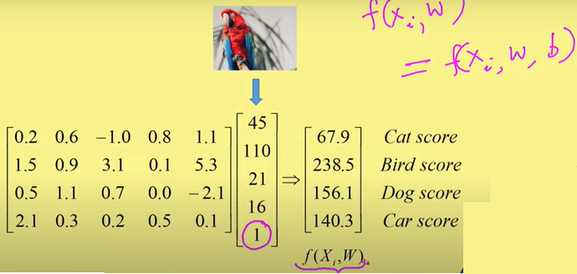

Slide 7
We want the score function to give the correct scores
If it is not correct then we need to update the parameters w1, w2, …w0.

Slide 8
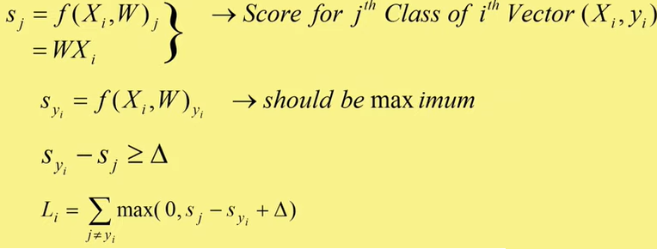
Loss function

Slide 9
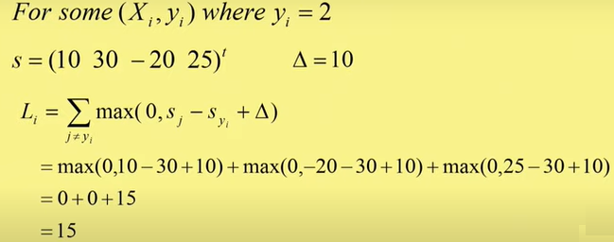

Slide 10
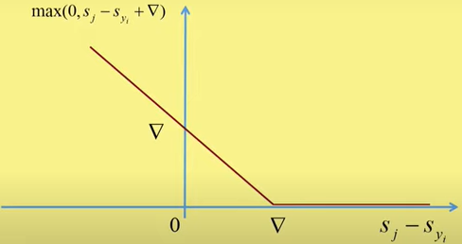
Hinge Loss

Slide 11
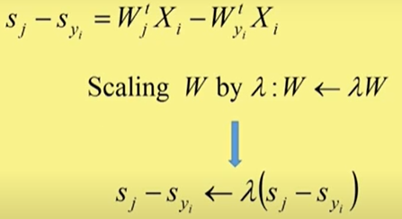
Regularization

Slide 12
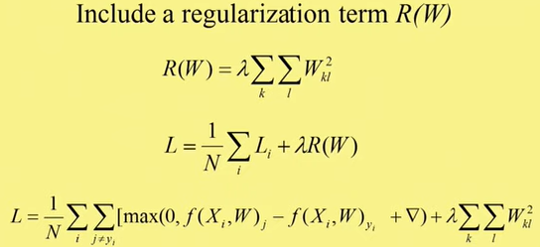
Two hyperparameters
Data Loss
Regularization Loss

Slide 13
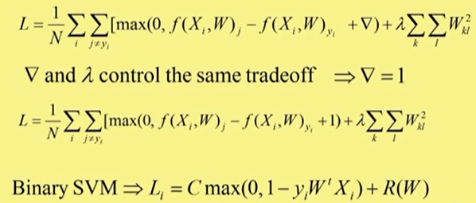

Slide 14
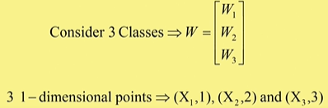


Loss Function Visulalization

Slide 15
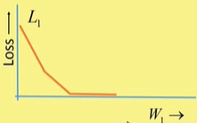
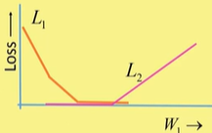
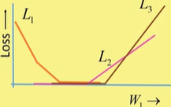

Slide 16
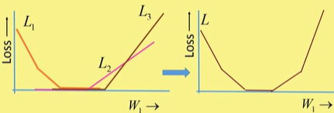

Slide 17
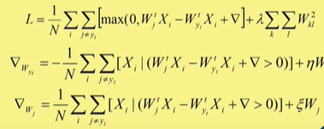

Slide 18
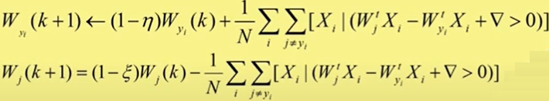
Gradient Descent

